Slide 1
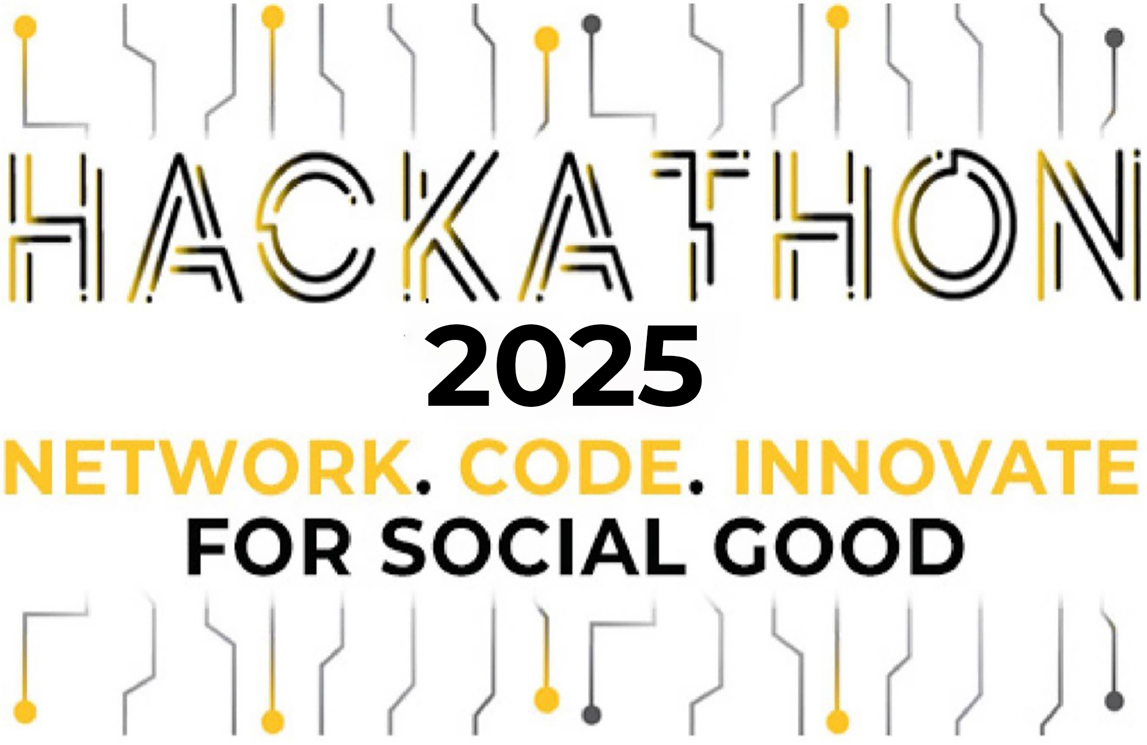


Help Missing Kids – 2025 HPCC Systems & ECL Code Challenge
Leveraging Data to Aid Our Heros
Sponsored by:
By: The Do-Gooders
Tyler Clanton Derick Burbano-Ramon
Ali Siddiqi

Slide 2
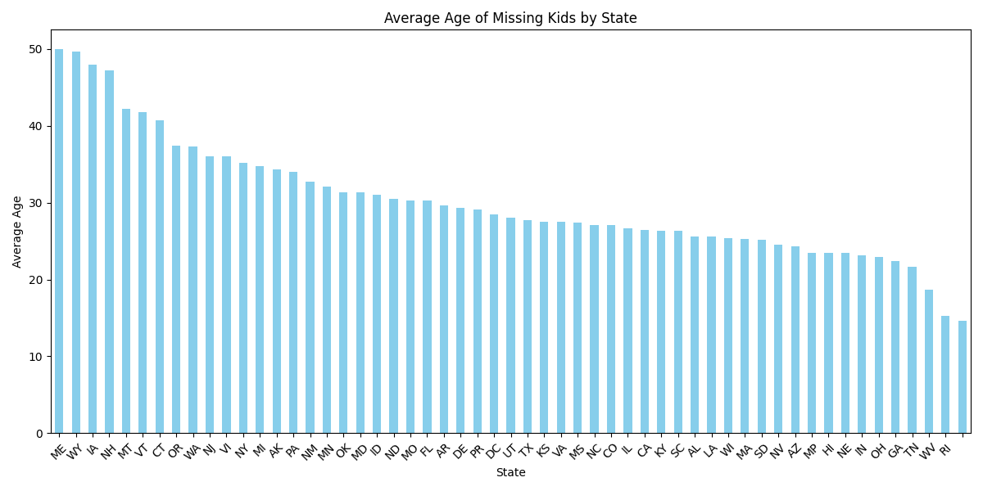
Every day, 1,000 children go missing in the U.S. – adding up to approx. 365,000 cases annually, which is 365,000 too many. The first 48 hours are critical, as most recoveries happen within this timeframe. Time is of the essence when it comes to bringing these kids home safely!
THE PROBLEM:
Notes:
1- some kidnapped/some were endangered runaways that sadly end up kidnapped , 2- as reads, 3- “We all are familiar w/ the AMBER Alert, however it by itself is simply not enough!

Slide 3

HPCC SYSTEMS & NCMEC PARTNERSHIP:
Our goal is to enhance awareness & provide valuable insights for law enforcement, helping prevent future cases and aiding in the successful recovery in current ongoing cases

Slide 4
THE DATA SOURCES:
Our team has implemented the following datasets from the NCMEC database:
Population
Population
Police
Hospitals

Slide 5
THE CHALLENGE:
Law enforcement faces many barriers in combatting the issue of missing children, some to mention are:
- limited real-time data
- Insufficient technological resources
- lack of integrated data sharing
AMBER Alerts are unfortunately not effective enough as we need them to be, and in some cases may aid the perpetrator evade law enforcement
Notes:
1- We bridged this gap by building a website that implements datasets to provide LE with real-time data on missing persons 2- many departments lack advanced tools, such as AI-driven predictive technology. As data analysts, we can give them the much-needed support to save children! 3- Back to the point of our website, this would also allow different departments to share said data that has been compiled and organized, which will help fine-tune their crime-fighting capabilities

Slide 6
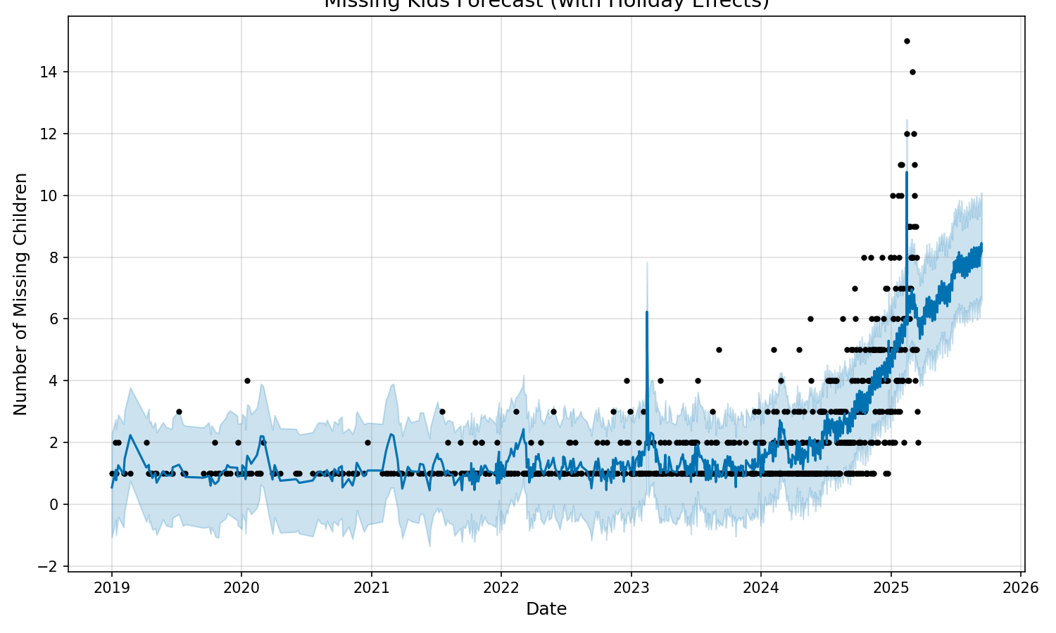
OUR APPROACH:
“Knowing is half the battle” and by leveraging data, we can identify trends in cases of child trafficking. Additionally, we can use ML to predict future cases to aid in successfully prevent future missing children. Our platform provides first responders with integrated data-sharing solutions, addressing a key gap in their resources.

Slide 7
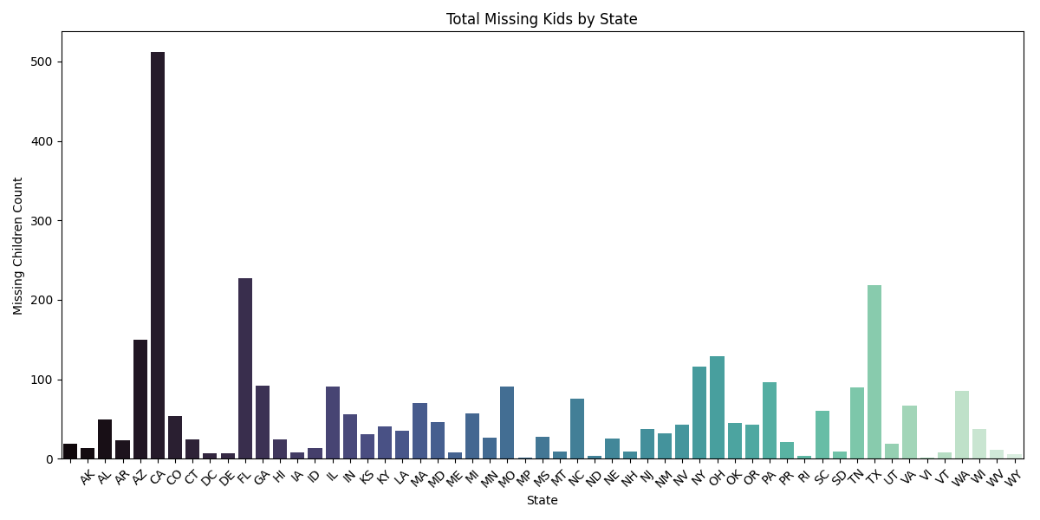
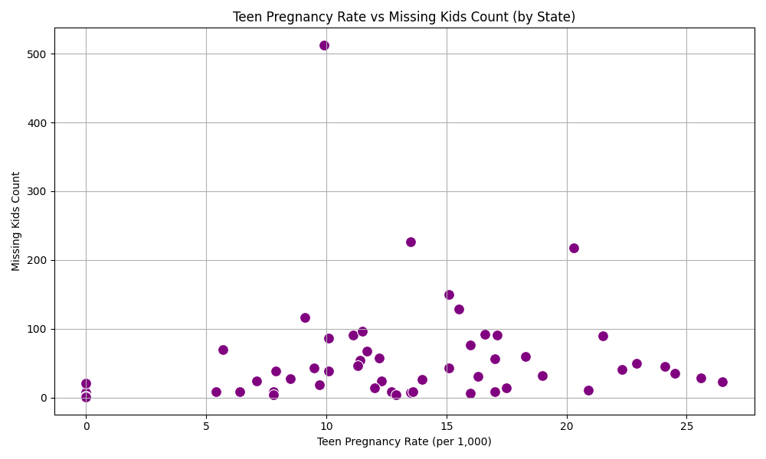
FINDINGS & INSIGHT:
Per the graphs above, our team noticed certain trends for these cases based off social factors such as teen pregnancy and even based on location(by state).
A higher rate of teen pregnancy seems to have a correlation with the number of missing children's cases
Certain states, such as CA, TX, and FL, have a higher concentration of cases as well, presumably due to their greater populations

Slide 8
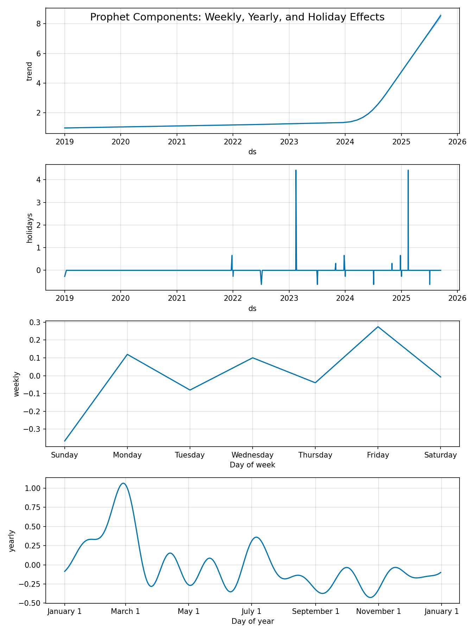
FINDINGS & INSIGHT:
In the following visualizations we’ve put together, we took note of:
an increase in cases on days such as Monday, Wednesday and Friday
a recent rise of cases within recent years
spikes during certain parts of the year/holidays (ex. July 4th, St. Patrick’s Day, Halloween)
With data like this, we can identify high-risk times of the year. Moving forward, parents/guardians can be advised to be more vigilant during these periods. Simultaneously, local police departments can increase patrols within their communities as a preventative measure.

Slide 9
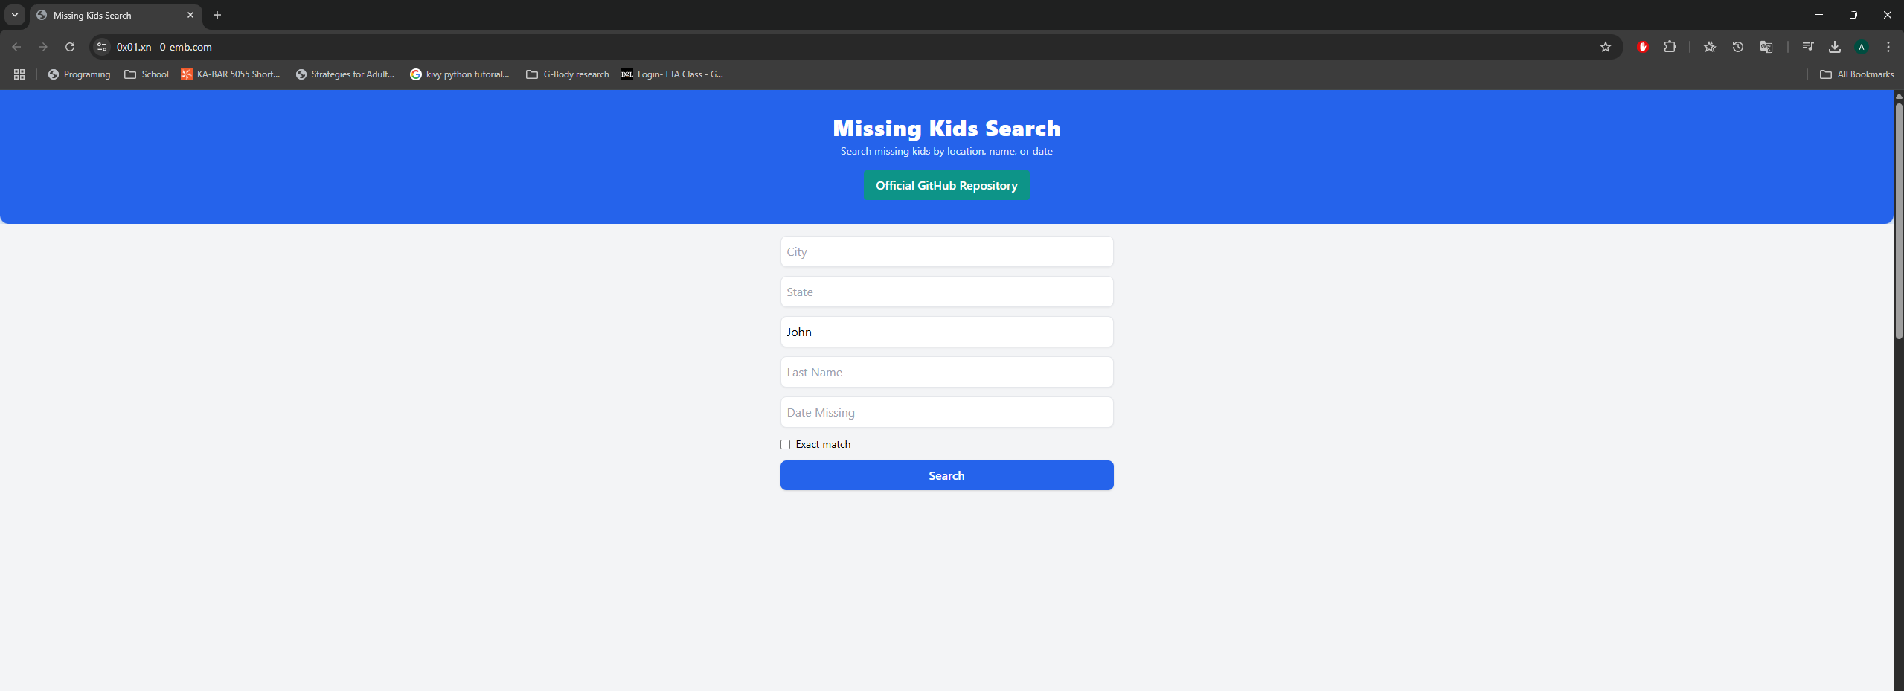
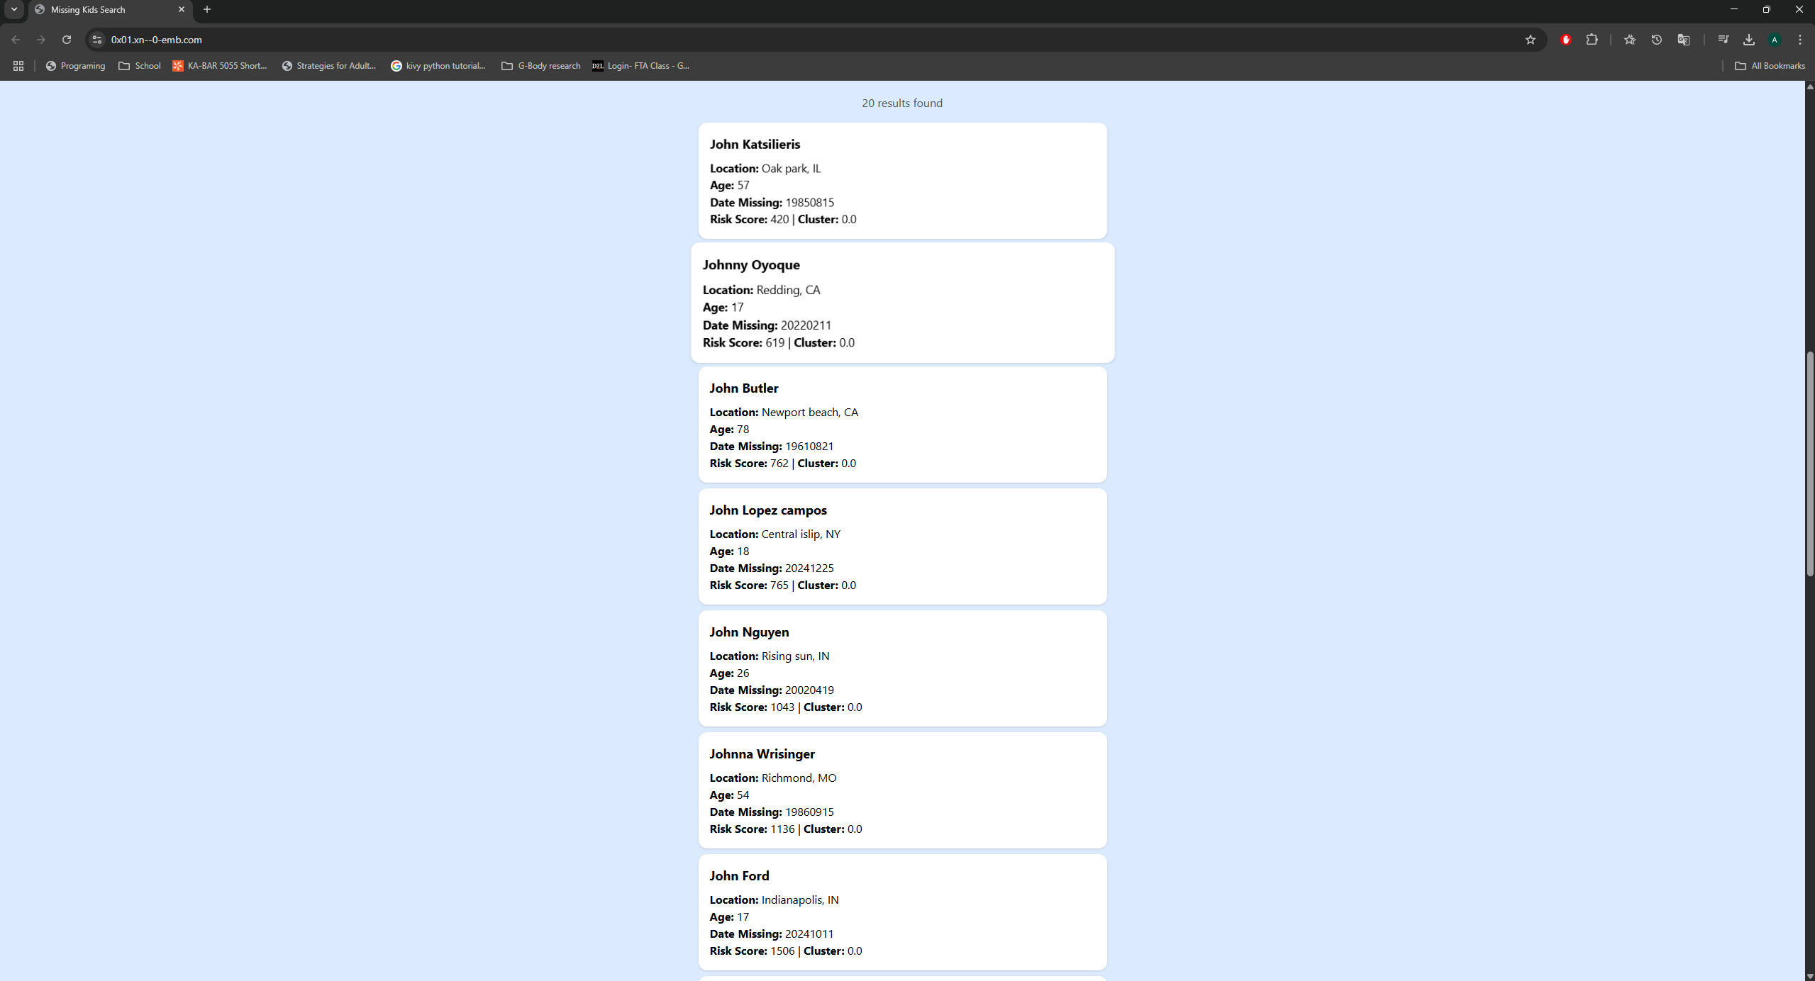
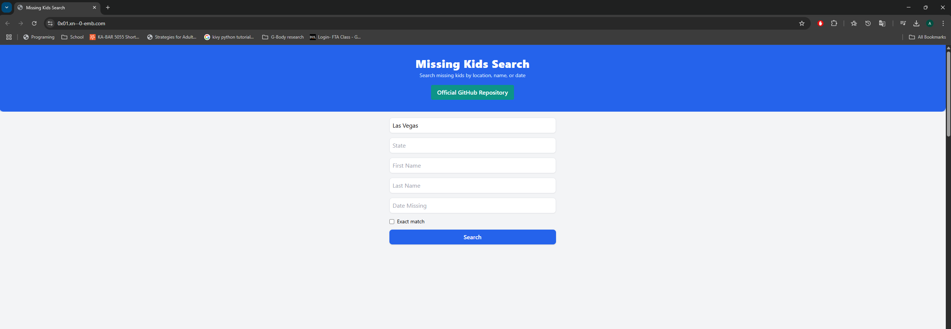
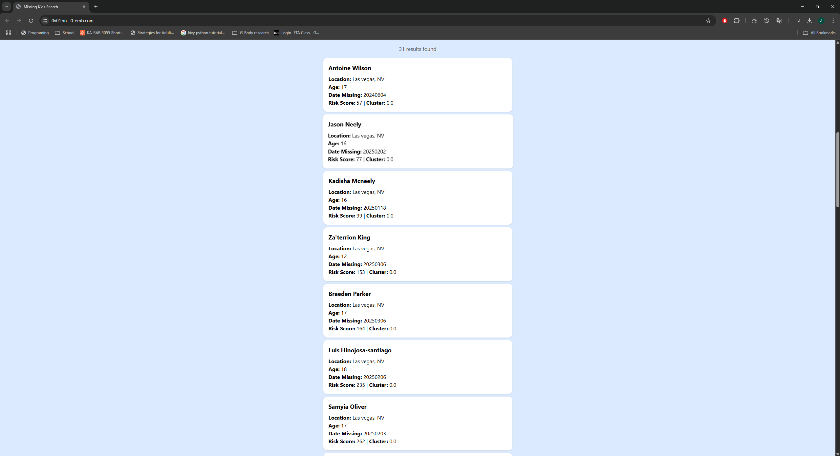
https://0x01.xn--0-emb.com/
LIVE DEMO
Ex 1). Searching for “John”
Output
Ex 2). Searching for “Las Vegas”

Slide 10
During the process of this Hackathon, we faced roadblocks such as: - ECL Communication issues - Data Display Errors - Plotting statistics w/ ML - Debugging the website - Deciding on a platform for asynchronous collaboration
OUR OBSTACLES:

Slide 11

CONCLUSION & TAKEAWAYS:
Our team made the most with the limited time we had, and it paid off as we gained valuable insights and learning experiences along the way!
This experience was eye-opening, demonstrating how technology and data analysis can be implemented to create a positive change in this world.

Slide 12
On behalf of The Do-Gooders, thank you for your time. We appreciate the opportunity to share our work!
For further questions and/or connections, feel free to reach out to us:
Name | Student Email
Derick Burbano-Ramon | dburbano@students.kennesaw.edu
Tyler Clanton | tclanto2@students.kennesaw.edu
Ali Siddiqi | asiddiqi@students.Kennesaw.edu
Looking forward to staying connected!

